Slide 1
What is your understanding of the phrase?
haringey.gov.uk
School Readiness

Slide 2
UNICEF School readiness – a conceptual framework
haringey.gov.uk
Definitions of School Readiness

Slide 3
The three dimensions of school readiness are:

Slide 4
What are the key skills that support preparation for school?

Slide 5
Independence, dressing, eating and toileting
Schools expect children to be sufficiently independent, able to use the toilet, dress and feed themselves and to be separate from parents.
Playing, sharing and turn-taking
Children are expected to have social skills, such as playing, taking turns and sharing, which are important for developing friendships and engaging in learning activities.
Basic written and verbal skills
Communicating in short, full and clear sentences and verbalising needs were important developmental milestones, along with the ability to hold a pen, recognise letters and numbers, and have some familiarity with nursery rhymes.
Following simple instructions
There is an expectation that children are able to sit down and listen, follow and act on simple instructions.
Ability to concentrate
Children are expected to be able to sit down, focus and concentrate for short
periods of time.

Slide 6
A child who is ready for school will be:
Curious and confident about learning.
Resilient and ready to take part.
Able to take risks, ask questions and find solutions.
Confidently active and be healthy.
Independent with self-care skills.
Comfortable to make friends and take turns.
Cared for and feel safe and secure.
Able to vocalise choices.

Slide 7
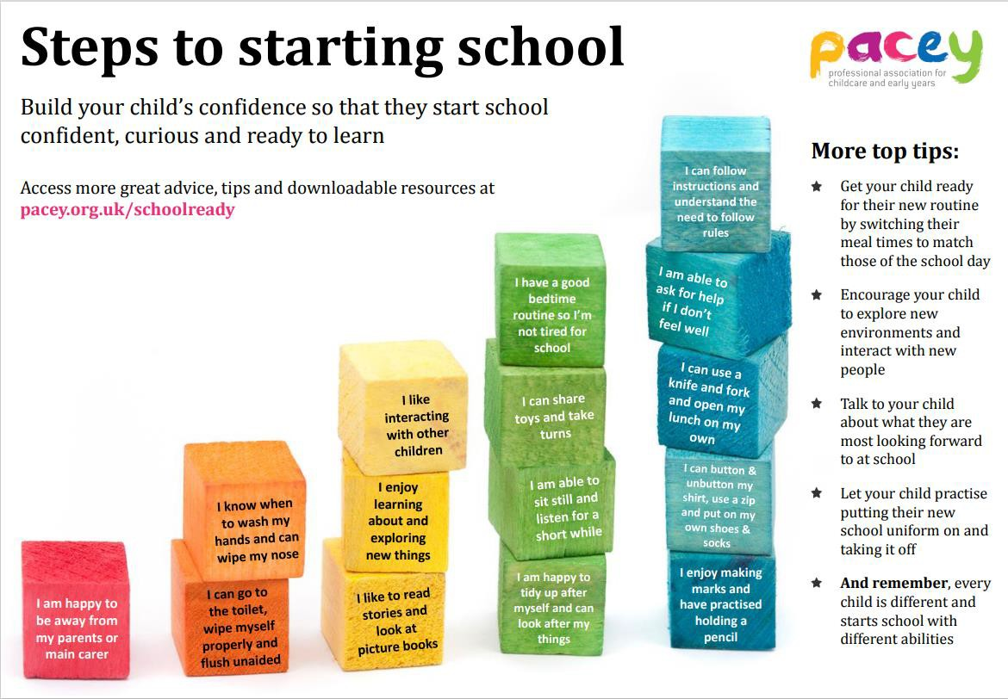

Slide 8
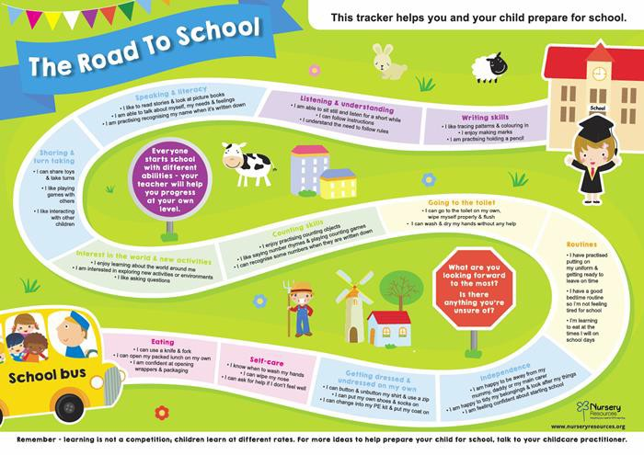

Slide 9
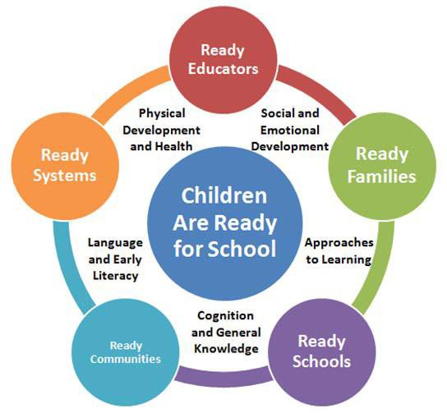

Slide 10
Moving to Reception Class

Slide 11
haringey.gov.uk

Slide 12
Transitions resources – Birth To 5 Matters
Helping-children-look-forward-to- school.docx (live.com)
School readiness: How to prepare your child for school - BBC Tiny Happy People
Are_you_ready_Good_practice_in_s chool_readiness.pdf (publishing.service.gov.uk)
Hello, 'big school' - managing transitions | early years alliance (eyalliance.org.uk)
Policy_Transition_July_21.pdf
(pemburyhouse.haringey.sch.uk)
Useful Resources

